Slide 1

UGANDA NATIONAL EXAMINATIONS BOARD
Training of teachers in the implementation of Continuous Assessment of the NLSC:
The Continuous Assessment Observation Checklist
April, 2024

Slide 2
Presentation outline
The CA Observation Checklist as an assessment tool.
Accessing the CA Observation Checklist
Structure of the CA Observation Checklist.
Use of the CA Observation Checklist in assessment

Slide 3
The CA Observation Checklist.
It is a manual tool that shall be used by the teachers to capture what a learner has demonstrated as evidence of acquisition of knowledge, skills, values or attitudes during the teaching learning process.
The Observation Checklist is developed based on the Continuous Assessment Framework and Project Assessment Tool
There are two observation checklists namely; subject and project

Slide 4
Accessing the CA Observation Checklist
The CA Observation Checklists shall be accessed from;
The installed desktop application
The hard copies distributed by UNEB
The UNEB portal

Slide 5
Uses of the CA Observation Checklists
The CA Observation Checklist serves the following purposes;
It guides the teacher and the learner on what is to be assessed.
It guides the teacher on when to conduct the assessment (class and term).
It provides the expected responses from the learners.
It serves as evidence of assessment and a record of the learner’s achievement.
It provides feedback on what a learner is able to do and the areas that need improvement.

Slide 6
Structure of the CA Observation Checklists Subject Observation Checklist
The Subject Observation Checklist is composed of the following;
School and learner details
Instructions for the facilitators
(iii) Theme: This is a group of topics with related body of knowledge
(iv) Topics: A specific body of knowledge e.g. Family is one of the topics in C.R.E
(v) Learning Outcomes: These are expressed as expected abilities (what a learner is expected to know, understand and do). E.g. Appreciate the values promoted by a family is one of the learning outcomes in CRE

Slide 7
Structure of the Subject Observation Checklist Ctd
iv) Competency: A set of demonstrable knowledge, skills, values and behaviors.
v)Generic skills: These are also known as soft skills that a learner has to acquire in order to be become a life long learner and adapt to the ever-changing world.
They lie at the heart of every subject and project and they enable a learner to access and deepen learning across the whole curriculum

Slide 8
Structure of the Subject Observation Checklist Ctd
vi) Levels of Ability: These are hierarchical levels of learning for the different domains. They are used to determine the learner’s degree of performance. (subject)
vii)Indicators: These are characteristics which a learner displays as evidence for acquiring a competency/skill. (subject and project)
An assessor is required to observe what a learner displays in relation to the competency in order to determine the degree/extent of performance on a particular item/task.

Slide 9
Structure of the Project Observation Checklist
The Project Observation Checklist is composed of the following;
School and learner details
Instructions for the facilitators
The project Theme: This shall be a statement giving the major idea that will guide project activities of learners for a specific period.
ii) A Competency: A set of demonstrable knowledge, skills, values and behaviors that the learner should acquire.
iii) Competence: What a learner knows, understands and can do
iv) Indicators: These are characteristics which a learner displays as evidence for acquiring a competence/ skill.

Slide 10
Using the CA Subject Observation Checklist in assessment
The checklist shall be used during the administration of the Continuous Assessment Item the teacher will have developed as follows:
Fill in the school and learner’s details
Observe the learner’s response(s) to the item administered
Tick the indicator(s) that you have observed the learner demonstrate at each level assessed for the subject competency and generic skill
Count the number of indicator(s) ticked per level assessed for the subject competency and generic skill
Record the number of indicator(s) for the subject competency and generic skill in the box provided as demonstrated below.

Slide 11
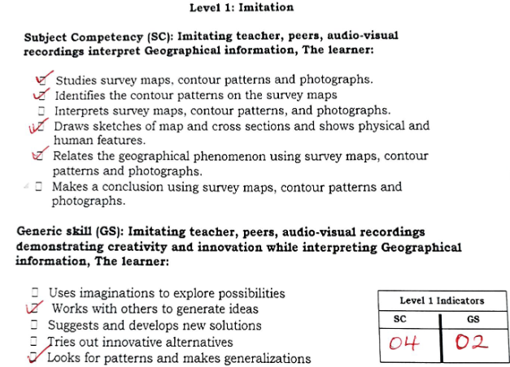
Using the CA Subject Observation Checklist in assessment

Slide 12
Using the CA Project Observation Checklist in assessment
The CA Project Observation checklist is used to capture learner’s achievement in the project activities as follows;
Fill in the school and learner’s details
Observe and tick the indicator(s) that the learner demonstrates in each competence
Count the number of indicator(s) ticked in each competence
Record the number of indicator(s) for the competence assessed in the box provided as demonstrated below.

Slide 13
Using the CA Project Observation Checklist in assessment Ctd

Slide 14
Hands on session
In groups, form a classroom environment with a teacher and learners.
Administer the Item developed .
Observe the learner’s responses.
On the observation checklist, tick the indictor(s) you have observed the learner demonstrate.
Count and record the number of indicators for the subject competency and generic skill

Slide 15
CONCLUSION
The observation checklists are assessment tools that every schools shall use to record the record the learner’s achievement in the subject as well as the project.
They are derived from the CAF and the Project Assessment Tool and they guide the teacher and the learner on what is to be assessed, when to assess and the expected responses from the learners.
The school administration and teachers should ensure that the record of learner’s achievement which are captured on the observation checklists are kept for future reference by internal and external stakeholders.

